Slide 1
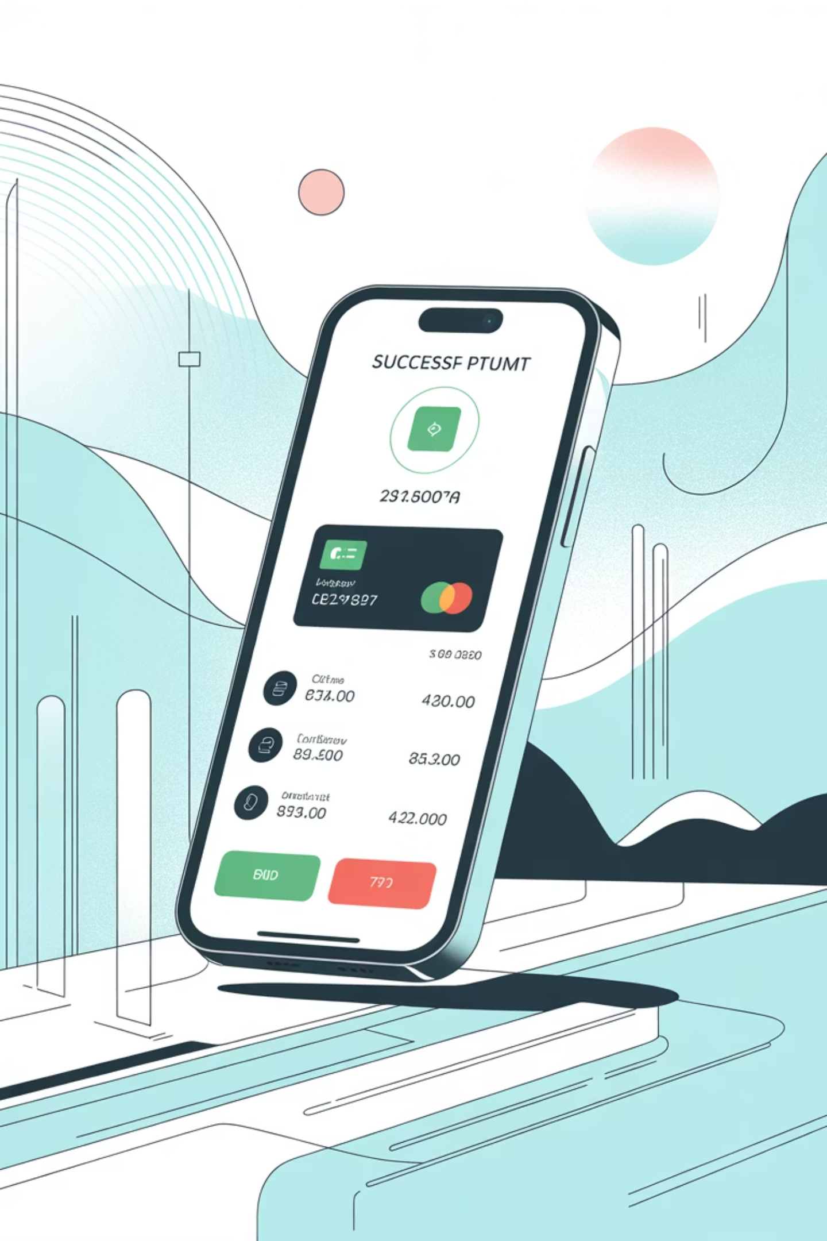
PhonePe Pulse: India Digital Payments Analytics
Data-Driven Insights & Strategic Recommendations
Presented by: Yamini S | Aspiring Data Scientist
Technical Stack: Python • SQL • MySQL • Streamlit • Data Visualization

Slide 2
Dataset Overview: Scale & Structure
6
24
36
700+
Years of Data
Quarters
States & UTs
Districts
2018 through 2023
Q1 to Q4 across all years
Nearly all Indian states and union territories
Granular geographic coverage
The analysis is based on structured data ingested from PhonePe Pulse GitHub, processed through a robust data pipeline. The database architecture comprises 9 MySQL tables that store both aggregated datasets and map-level transaction data, optimized specifically for analytical querying. This comprehensive scale enables seamless analysis from macro-level national trends down to micro-level district performance, providing stakeholders with multi-layered insights into India's digital payment ecosystem.

Slide 3




Transaction Growth: National Performance
Exponential Growth
Consistent Momentum
Nationwide Shift
Total transactions surpassed 100+ million per quarter in early years, with transaction value reaching ₹17,000+ crore in Q1 2018 and accelerating rapidly thereafter
Strong quarter-on-quarter growth observed consistently across all reporting periods, demonstrating sustained adoption
Digital payments evolved from urban adoption to nationwide behavior, driven by UPI convenience and widespread smartphone penetration
Key Insight: PhonePe has transformed from being merely a payment app into becoming core financial infrastructure for India's digital economy.

Slide 4
State-Wise Transaction Patterns
Geographic Concentration of Value
Maharashtra
Karnataka
Tamil Nadu
Economic powerhouse and financial capital driving highest transaction volumes
Technology hub with strong digital adoption across urban and semi-urban centers
Industrial base with widespread merchant acceptance and consumer penetration
Uttar Pradesh
Telangana
Large population base showing rapid adoption in Tier-2 and Tier-3 cities
Hyderabad-centric growth with expanding regional presence
These states consistently contribute the highest transaction value in rupees crore, representing economic hubs and digitally mature markets. The geographic concentration reveals both market maturity in established centers and significant expansion opportunities in emerging regions.

Slide 5
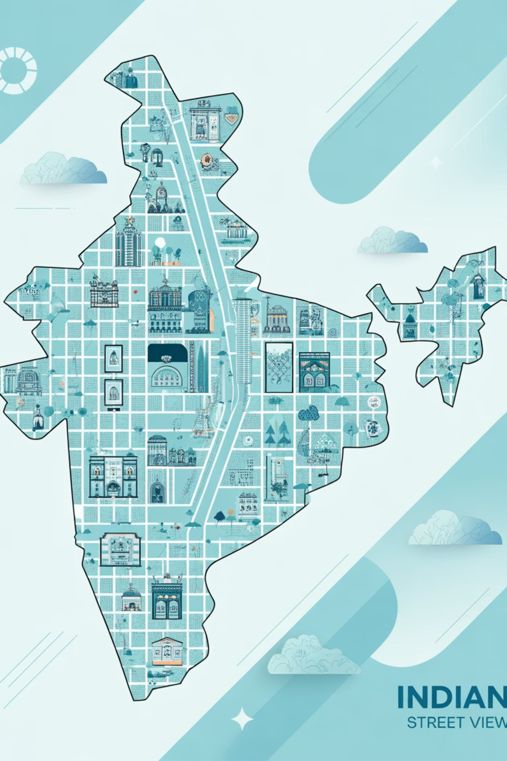

District-Level Market Expansion
Micro-Market Opportunities
Key Findings
Strategic Value
Top districts generate ₹100+ lakh per quarter
Metro districts dominate current volume
Several non-metro districts show rapid adoption rates
Emerging cities demonstrate untapped potential
District-level analysis helps identify merchant onboarding opportunities, design targeted campaigns, and determine infrastructure investment zones. Localized strategies can significantly increase adoption in underserved areas.
Business Impact: Granular district data enables precision targeting and resource allocation for maximum ROI on expansion initiatives.

Slide 6




User Adoption & Device Dominance
Device-Wise User Distribution Analysis
Android Dominance
Xiaomi Lead
Samsung Presence
Vivo Growth
Android devices command overwhelming majority of user base, driven by affordability and widespread availability across income segments
Xiaomi smartphones show highest adoption rates, particularly in value-conscious segments and emerging markets
Samsung maintains strong position across premium and mid-range categories with reliable performance
Vivo demonstrates rapid adoption, particularly among younger demographics and Tier-2 city users
Premium devices, particularly Apple iPhones, contribute significantly less volume despite higher per-user transaction values. This insight reveals that PhonePe's success is fundamentally driven by mass-market Android penetration rather than premium device adoption. Strategic Recommendation: Continue optimizing app performance and user experience for low-cost and mid-range Android devices to maintain competitive advantage.

Slide 7

Insurance Adoption Analysis
Insurance as an Emerging Segment
01
Current State
Insurance transaction value remains substantially lower than core payment transactions, with concentrated adoption in select states
02
Barriers Identified
Limited awareness, trust gaps, and complexity in product understanding hinder mainstream adoption
03
Growth Trajectory
Insurance adoption is growing steadily but not yet achieved mainstream penetration across user base
04
Market Opportunity
Huge untapped potential exists for micro-insurance products, awareness campaigns, and regional education initiatives
The data reveals a clear opportunity to expand beyond core payment functionality. By addressing awareness and trust barriers through targeted education and simplified product offerings, PhonePe can unlock significant revenue diversification while providing valuable financial protection to millions of users.

Slide 8



Business Case Summary
How Data Answered Business Questions
Transaction Dynamics
Device Dominance
Insurance Growth
aggregated_transaction table revealed growth patterns, value trends, and seasonal variations
aggregated_user data uncovered Android-first adoption and brand preferences
aggregated_insurance analysis identified adoption barriers and expansion opportunities
Map-Level Insights
Technical Execution
map_transaction and map_user tables enabled geographic analysis, revealing state and district performance variations and market concentration patterns
SQL aggregations produced real metrics, while visualizations clearly displayed trends and patterns for stakeholder consumption
Outcome: Comprehensive data analysis translated raw transaction records into actionable business insights, demonstrating the power of analytics to drive strategic decision-making in the fintech sector.

Slide 9
Strategic Recommendations
Data-Backed Priorities for Growth
Strengthen Presence in Underperforming States
Optimize Android-First User Experience
Increase Insurance Adoption Through Education
Launch targeted campaigns and merchant incentives in low-adoption regions to accelerate market penetration
Continue prioritizing app performance on low-cost and mid-range devices that dominate the user base
Develop micro-insurance products with simplified terms and regional education initiatives to build trust
Focus on High-Growth Districts
Expand Merchant Network Aggressively
Concentrate expansion resources on emerging districts showing rapid adoption rates for maximum impact
Accelerate merchant onboarding programs in Tier-2 and Tier-3 cities to create ecosystem density
These recommendations align directly with observed user behavior and transaction patterns, providing a clear roadmap for sustained growth and market leadership in India's rapidly evolving digital payments landscape.

Slide 10





Conclusion & Value Delivered
End-to-End Data Pipeline
Demonstrated complete ETL process from raw data ingestion through SQL transformation to Streamlit visualization
Real-World Business Analytics
Translated complex transaction data into clear, actionable insights for strategic decision-making
Decision-Oriented Dashboards
Built interactive visualizations that enable stakeholders to explore trends and patterns independently
Scalable Analytical Design
Created modular database architecture and query patterns that accommodate future data expansion
Final Takeaway: PhonePe Pulse data reveals how digital payments have fundamentally transformed India's financial landscape, and how sophisticated data analytics enables smarter, evidence-based business strategy in the fintech sector.

Slide 11




Thank You
syamini1428@gmail.com
LinkedIn
GitHub

